Slide 1
UNIT VI : Data Visualization and Hadoop
Introduction to Data Visualization, Challenges to Big data visualization, Types of data visualization, Data Visualization Techniques, Visualizing Big Data, Tools used in Data Visualization, Hadoop ecosystem, Map Reduce, Pig, Hive, Analytical techniques used in Big data visualization, Data visualization with Tableau. Data Visualization using Python : Line plot, scatter plot, Histogram, density plot, Box- plot

Slide 2
Introduction to Data Visualization
Data visualization is the study of representing data or information in a visual form. Visuals come in the different forms like graphs, images, diagrams, or animations etc.
Visualization is an excellent medium to analyze, comprehend, and share the information.

Slide 3
Big Data Visualization
Data visualization is representing data in some systematic form including attributes and variables for the unit of information.
Visualization is an important approach to helping Big Data get a complete view of data and discover data values.
Big data are high volume, high velocity, and/or high variety datasets that require new forms of processing to enable enhanced process optimization, insight discovery and decision making. Challenges of Big Data lie in data capture, storage, analysis, sharing, searching, and visualization

Slide 4
Advantages of visualization:
Visual images help to transmit a huge amount of information to the human brain at a glance.
Visual images help in establishing relationships and distinction between different patterns, or processes easily.
Visual interpretation help in exploring data from different angles, which help gain insights.
Visualization helps in identifying problems and understanding trends and outliers.
Visualization point out key or interesting breakthroughs in a large dataset.

Slide 5
Benefits of visualization :
Improved decision making
Better adhoc data analysis
Improved collaboration/information sharing
Provide self-service capabilities to end users
Increased return on investment (ROI)
Time saving
Reduced burden on IT

Slide 6
Types of Data Visualisation

Slide 7
Name | Description | Tool
1D/Linear | List of Items | No tool is used
2D/Planar | cartogram, dot distribution map | Google maps API
3D/Volumetric | 3D computer Models | AutoQ3D, TrueSpace
Temporal | Timeline , Time series Time Flow, Gantt chart | Excel Timeplot, Google Charts
Mutidimentional | pie chart, Histogram, bar chart, | Google Charts, Tableau Public
Tree/Hierachical | Dendogram, Wedge Stack graph | Sci2, Google Charts. Network workbench
Network | Matrix, Node LInk diagram | Google Fusion Tables

Slide 8
Techniques used for visual data Representation :
ISOLINE,
Isosurface,
Direct volume rendering,
Streamline, Map,
Parallel coordinate plot,
Venn Diagram,
Time line,
Euler Diagram,
Hyperbolic trees,
Cluster Diagram,

Slide 9
Applications of Data Visualisation :
Education
Information
Production
Science
Systems Visualisation
Visual Communication
Visual analytics.

Slide 10
Tools Used in Data Visualisation :
Excel
Last.Forward,
Digg.Com
Pics,
Arc
Google Chrats API
Twittearth
Tag Galaxy
Tableau

Slide 11
Challenges of Big Data Visualization
Scalability and dynamics are two major challenges in visual analytics.
The visualization-based methods take the challenges presented by the “four Vs” of big data and turn them into following opportunities.
• Volume: The methods are developed to work with an
immense number of datasets and enable to derive
meaning from large volumes of data.
• Variety: The methods are developed to combine as many
data sources as needed.
• Velocity: With the methods, businesses can replace batch
processing with real-time stream processing.
• Value: The methods not only enable users to create
attractive infographics and heatmaps, but also create
business value by gaining insights from big data.

Slide 12
Visualization of big data with diversity and heterogeneity (structured, semi-structured, and unstructured) is a big problem.
Speed is the desired factor for the big data analysis. Designing a new visualization tool with efficient indexing is not easy in big data.
Cloud computing and advanced graphical user interface can be merged with the big data for the better management of big data scalability.
Visualization systems must contend with unstructured data forms such as graphs, tables, text, trees, and other metadata.
Big data often has unstructured formats. Due to bandwidth limitations and power requirements, visualization should move closer to the data to extract meaningful information efficiently.
Because of the big data size, the need for massive parallelization is a challenge in visualization.
The challenge in parallel visualization algorithms is decomposing a problem into independent tasks that can be run concurrently

Slide 13
Conventional Data Visualization Methods
Many conventional data visualization methods are often used. They are: table, histogram, scatter plot, line chart, bar chart, pie chart, area chart, flow chart, bubble chart, multiple data series or combination of charts, time line, Venn diagram, data flow diagram, and entity relationship diagram, etc. In addition, some data visualization methods have been used although they are less known compared the above methods. The additional methods are: parallel coordinates, treemap, cone tree, and semantic network, etc.

Slide 14
Hadoop MapReduce- Java-based Processing Framework for Big Data
MapReduce programming paradigm uses a two-step data analysis process- Map Stage and Reduce Stage (reduce phase is optional).
The map stage takes a set of data and converts it into another set where data elements are broken down into key-value pairs or tuples. Reduce job takes the output of the map function and combines them into smaller set of tuples or key-value pairs.

Slide 15
MapReduce Terminologies
Job - It is the complete process to execute including the mappers, the input, the reducers and the output across a particular dataset.
Task - Every job is divided into several mappers and reducers. A portion of the job executed on a slice of data can be referred to as a task.
JobTracker - It is the master node for managing all the jobs and resources in a hadoop cluster.
TaskTracker - These are the agents deployed to each machine in the hadoop cluster to run Map and Reduce tasks and then report the status to the JobTracker after execution.

Slide 16
Hadoop WordCount operation occurs in 3 stages –
Mapper Phase
Shuffle Phase
Reducer Phase

Slide 17
Mapper Phase
The text from the input text file is tokenized into words to form a key value pair with all the words present in the input text file. The key is the word from the input file and value is ‘1’.
For Example the sentence “PICT is an engineering College”. The mapper phase in the WordCount example will split the string into individual tokens i.e. words. In this case, the entire sentence will be split into 5 tokens (one for each word) with a value 1.

Slide 18
(PICT,1)
(is,1)
(an,1)
(engineering,1)
(College,1)
Key-Value pairs from Hadoop Map Phase Execution-

Slide 19
Shuffle Phase Execution:
After the map phase execution is completed successfully, shuffle phase is executed automatically wherein the key-value pairs generated in the map phase are taken as input and then sorted in alphabetical order.
(an,1)
(College,1)
(engineering,1)
(is,1)
(PICT,1)

Slide 20
Reducer Phase Execution:
In the reduce phase, all the keys are grouped together and the values for similar keys are added up to find the occurrences for a particular word. It is like an aggregation phase for the keys generated by the map phase. The reducer phase takes the output of shuffle phase as input and then reduces the key-value pairs to unique keys with values added up.

Slide 21
All Engineering colleges in Pune
Output after reduce
All 1
Engineering 2
Colleges 1
college

Slide 22
Apache Hadoop framework is composed of the following modules
Hadoop Common: contains libraries and utilities needed by other Hadoop modules
Hadoop Distributed File System (HDFS): a distributed file-system that stores data on the commodity machines, providing very high aggregate bandwidth across the cluster
Hadoop YARN: a resource-management platform responsible for managing compute resources in clusters and using them for scheduling of users' applications.

Slide 23
Hadoop MapReduce: a programming model for large scale data processing.
Apache Hadoop's MapReduce and HDFS components originally derived respectively from Google's MapReduce and Google File System (GFS) papers.
Beyond HDFS, YARN and MapReduce, the entire Apache Hadoop "platform" is now commonly considered to consist of a number of related projects as well: Apache Pig, Apache Hive, Apache HBase, and others.

Slide 24
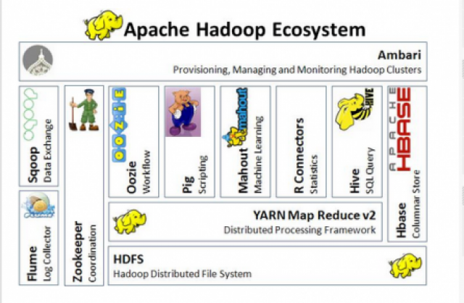

Slide 25
Apache Pig and Apache Hive, among other related projects, expose higher level user interfaces like Pig latin and a SQL variant respectively. The Hadoop framework itself is mostly written in the Java programming language, with some native code in C and command line utilities written as shell-scripts.

Slide 26
HDFS and MapReduce
There are two primary components at the core of Apache Hadoop.
the Hadoop Distributed File System (HDFS) and the MapReduce parallel processing framework. These are both open source projects, inspired by technologies created inside Google.

Slide 27
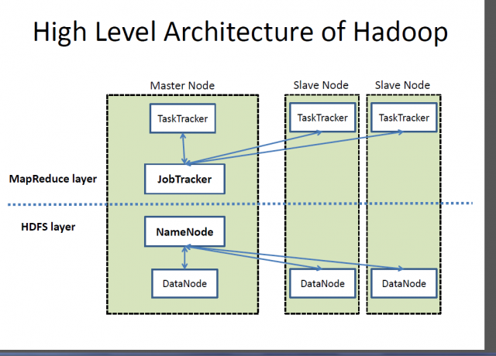

Slide 28
Hadoop distributed file system
The Hadoop distributed file system (HDFS) is a distributed, scalable, and portable file-system written in Java for the Hadoop framework. Each node in a Hadoop instance typically has a single namenode, and a cluster of datanodes form the HDFS cluster. The situation is typical because each node does not require a datanode to be present. Each datanode serves up blocks of data over the network using a block protocol specific to HDFS. The file system uses the TCP/IP layer for communication. Clients use Remote procedure call (RPC) to communicate between each other.

Slide 29
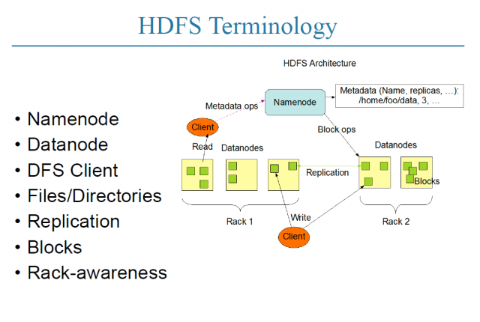

Slide 30
https://opensource.com/life/14/8/intro-apache-hadoop-big-data

Slide 31
hadoop jar
The hadoop jar command runs a program contained in a JAR file. Users can bundle their MapReduce code in a JAR file and execute it using this command.
Syntax
hadoop jar <jar> [<arguments>]
Running from a JAR file:
The simple Word Count program is another example of a program that is run using the ﻿hadoop jar command. The wordcount functionality is built into the hadoop-*examples.jar program.
We have to pass the file, along with the location, to Hadoop with the hadoop jar command and Hadoop reads the JAR file and executes the relevant instructions.
The Word Count program reads files from an input directory, counts the words, and writes the results of the application to files in an output directory.

Slide 32
https://hadoop.apache.org/docs/stable/hadoop-mapreduce-client/hadoop-mapreduce-client-core/MapReduceTutorial.html

Slide 33
The WordCount application :
The Mapper implementation, via the map method, processes one line at a time, as provided by the specified TextInputFormat. It then splits the line into tokens separated by whitespaces, via the StringTokenizer, and emits a key-value pair of < <word>, 1>
< Hello, 1>
< World, 1>
< Bye, 1>
< World, 1>

Slide 34
public void map(Object key, Text value, Context context ) throws IOException, InterruptedException {
StringTokenizer itr = new StringTokenizer(value.toString());
while (itr.hasMoreTokens())
{
word.set(itr.nextToken());
context.write(word, one);
} }

Slide 35
WordCount also specifies a combiner. Hence, the output of each map is passed through the local combiner (which is same as the Reducer as per the job configuration) for local aggregation, after being sorted on the keys.
job.setCombinerClass(IntSumReducer.class);

Slide 36
The Reducer implementation, via the reduce method just sums up the values, which are the occurrence counts for each key (i.e. words in this example).
public void reduce(Text key, Iterable<IntWritable> values, Context context ) throws IOException, InterruptedException
{ int sum = 0; for (IntWritable val : values)
{ sum += val.get(); }
result.set(sum);
context.write(key, result);
}

